Slide 1
Building a model to predict e-commerce order cancellations
Natalia Shcheglova, Aug 27, 2024

Slide 2

The Problem
Loss of revenue
Disruption of fulfillment process
Costs associated with processing cancelled orders

Slide 3



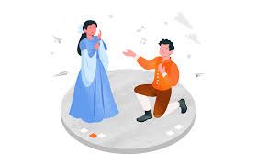
Why Would We Want To Predict Cancellations?
Reduce cost
Understand customers
Improve operational efficiency
Win back revenue

Slide 4
The Data
Amazon Sale Report for India market for Q2, 2022
Date
Product details
Price
Shipment address
Shipment details
Promotion
Month
Category
State
Shipment type
Free shipping
Day
Style
City
Fulfilment merchant
Free financing
Time of the month
Size
Zip
SKU
Coupon
Weekend
No promotion

Slide 5
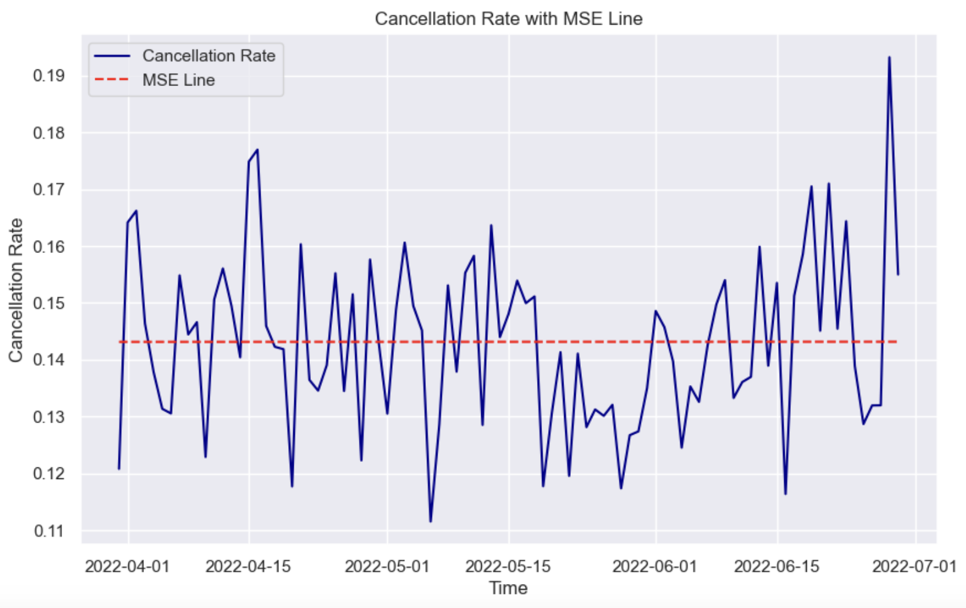
Data Exploration
Number of cancellations
Cancellation rate =
Total orders

Slide 6
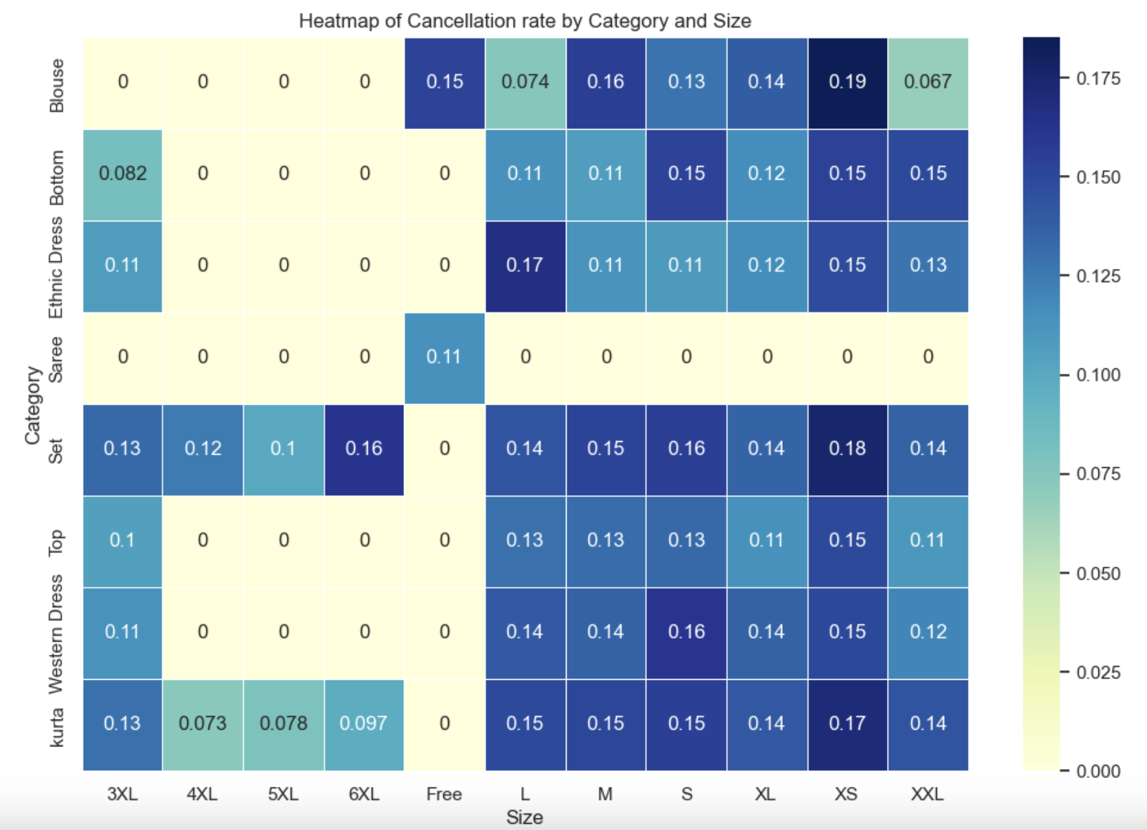
Cancellation Rate Per Product Category And Size
Does size matter?
Notes:
Maybe one of the reasons why customers cancel is that they are unsure about the size selected?

Slide 7
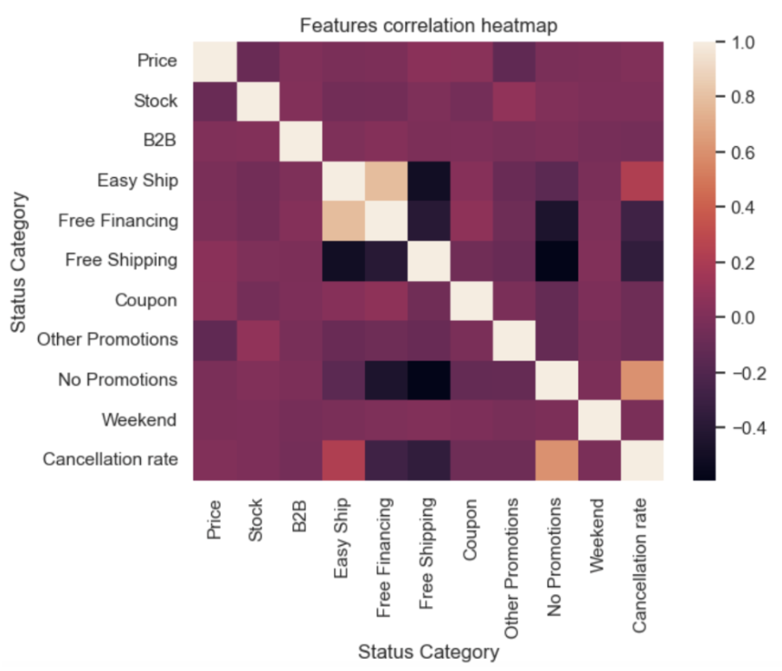
Correlation With Promotions

Slide 8
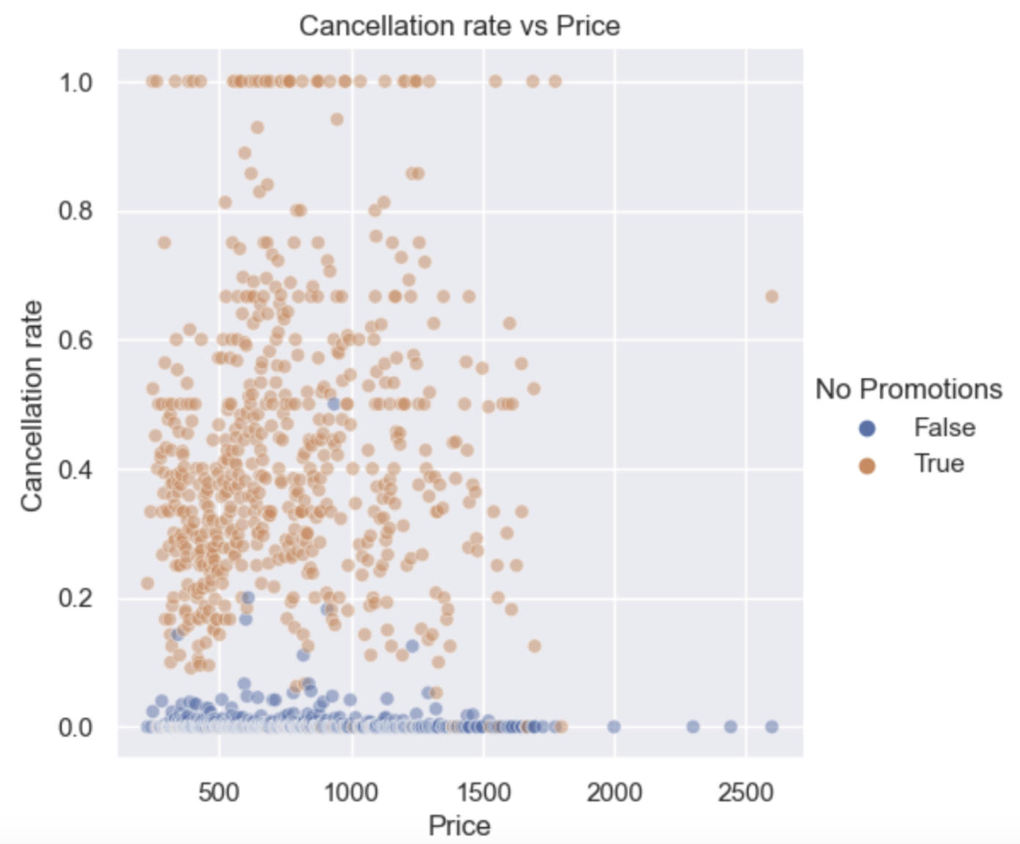
Cancellation Rate And Price
Notes:
There doesn’t appear to be any correlation of cancellation rate with price, but if we overlay this with Promotions variable, we can see that vast majority of orders with promotion (in blue) has a very low cancellation rate.

Slide 9
Modelling
Binary classification: 1 for cancelled order, 0 for shipped.
Imbalanced data:14% of orders are tagged as Cancelled.
Recall as a main metric for performance assessment.
Pre-processing:
1. Label encoding.
2. Target-encoding for SKU.
3. One-hot encoding for other categorical features.
4. Scaling with RobustScaler.
5. Splitting into train (70%) and test(30%) data.
6. Resampling.
Selecting a model:
Logistic regression
KNN Classifier
Random Forest
Decision Tree
Hyperparameter tuning:
Bayesian optimization.
Using StratifiedKFold for cross validation (5 folds).

Slide 10
Models Comparison
Model | accuracy | precision (for label 1) | recall (for label 1) | f1-score (for label 1)
Logistic regression | 0.81 | 0.42 | 0.94 | 0.58
KNN Classifier | 0.8 | 0.4 | 0.84 | 0.55
Decision Tree | 0.76 | 0.36 | 0.98 | 0.53
Random Forest | 0.91 | 0.77 | 0.55 | 0.64

Slide 11
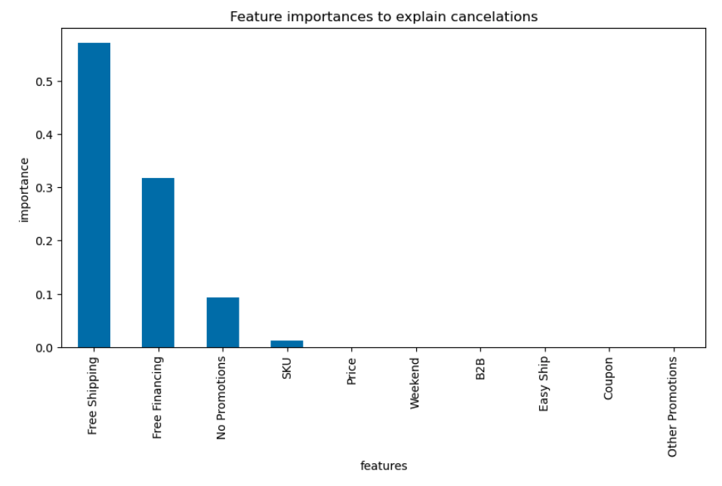
Final Results
Recall: 0.98
Precision: 0.31
F1 score: 0.47
Notes:
Orders with Free shipping are associated with fewer cancellations. An intuitive explanation could be that customer satisfaction is higher for orders with free shipping due to the higher perceived value of the order.
Orders with Free financing are associated with fewer cancellations. A possible explanation could be also tied to customer satisfaction, or maybe free financing has some rules (like, returns are not allowed or the terms are more strict).
Orders with no promotion have a higher cancellation rate. As opposed to orders with promotions, orders without promotions may have lower perceived value and result in lower customer satisfaction.
Some SKUs have higher cancellations. This could be due to concerns about the quality of some products (perhaps, the website has some bad reviews which make customers hesitate and cancel their order), or maybe some SKUs are out of stock or the fulfillment process takes more time.

Slide 12

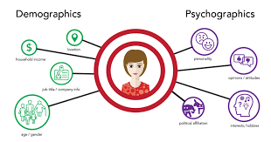
Ideas To Improve The Model
Incorporate wait time
Include customer characteristics:
Age
Gender
First-time customer vs repeat customer.
Time spent on the website before placing an order.
Notes:
- fulfillment time (for the orders with the status ‘Shipped’) and the time elapsed between the order placement and cancellation (for orders with the status ‘Canceled’) since long wait times could be one of the reasons for cancellations.
since customer characteristics and spontaneity of purchase could also have an impact on the propensity to cancel the order.

